Slide 1

Facebook Engagement Analysis(ML)
Tanush Garg

Slide 2
Agenda
1
2
3
4
5
Introduction & Dataset Overview
Engagement Analysis
Correlation Analysis
Clustering & Post Types
Conclusion & Key Takeaways

Slide 3
Introduction
Goal: To analyze engagement patterns on Facebook posts by Thai retail live sellers and draw actionable business insights.
Objectives:
Understand how time of posting affects user engagement.
Investigate the relationship between reactions, comments, and shares.
Use K-Means clustering to group posts by behavior and engagement.
Identify which post types perform better in terms of user interaction.
Provide recommendations to optimize post timing and format.

Slide 4
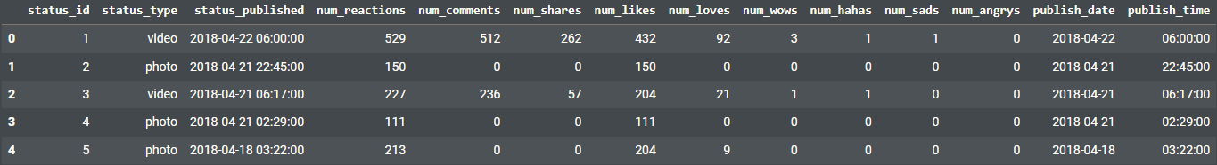
Dataset Overview
Key Details
Visual Element
Source:
UCI Machine Learning Repository
Facebook Live Sellers in Thailand Dataset
Structure:
Rows (instances): 7,050
Columns (after cleaning): 14
Important Columns:
status_type (post format: photo, video, status, link)
status_published (date & time)
num_reactions, num_comments, num_shares
Reaction breakdown: num_likes, num_loves etc.

Slide 5
Data Preprocessing
Removed Unwanted Columns
Dropped the last 4 redundant columns → Retained only relevant features
Handled Missing Values
No missing values in the dataset
Parsed Time Information
Converted status_published to datetime
Encoded Categorical Data
One-hot encoded status_type → Needed for K-Means clustering
Scaled Numerical Features
Applied StandardScaler to all features before clustering

Slide 6
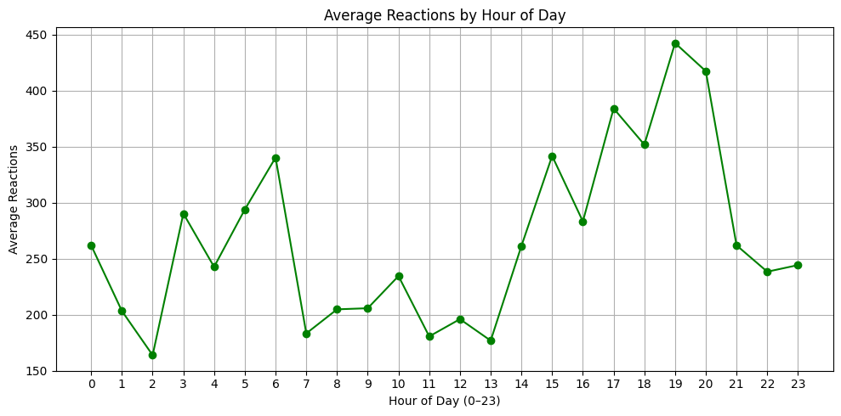
Average Reactions vs Hour of Day
Line Plot
Analysis
Morning Peak (3 AM): ~290 reactions Likely catching international audiences or early risers
Evening Prime Time (19:00 / 7 PM): Highest peak at ~440 reactions When most users are active after work
Secondary Evening Peak (15:00 / 3 PM): ~340 reactions Afternoon browsing period
Early Morning Trough (2 AM): Lowest point at ~165 reactions
Mid-day Lull (07:00–13:00): Consistently lower engagement during work/school hours
Late Night Decline (21:00–23:00): Gradual decrease as users wind down

Slide 7
When to Post for Maximum Reach
Optimal Posting Schedule
Primary window: 18:00–20:00 (6–8 PM) for maximum reach
Secondary window: 14:00–16:00 (2–4 PM) for afternoon engagement
Avoid: 01:00–02:00 AM and 07:00–13:00 for regular content
Content Strategy
Schedule high-priority posts (new products, promotions) during the 19:00 peak
Use the afternoon window for customer service responses and follow-ups
Consider the early morning peak (3 AM) for targeting international customers or time-sensitive deals

Slide 8
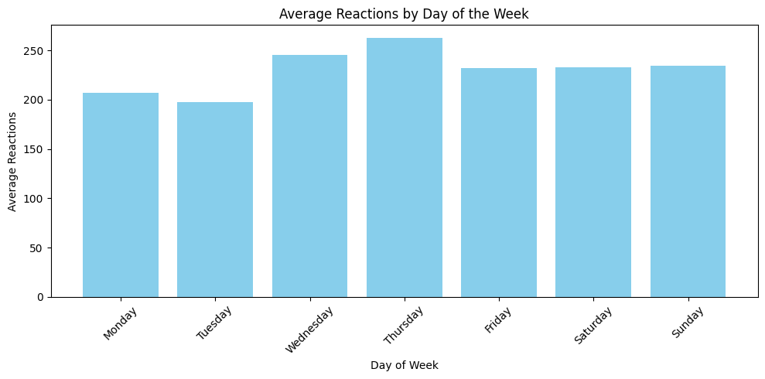
Average Reactions vs Day of Week
Bar Graph
Analysis
Thursday leads with ~260 reactions – highest engagement day
Wednesday follows closely at ~245 reactions
Both mid-week days show significantly higher activity than weekends
Monday–Tuesday show the lowest engagement (~205–200 reactions)
Classic "Monday blues" effect with users less active at week start
Weekend Performance
Friday–Sunday maintain consistent moderate engagement (~230–235 reactions)
Weekend activity remains steady but below mid-week peaks

Slide 9
Mid-Week Magic: Winning Days to Post
Content Scheduling
Primary posting days: Wednesday–Thursday for maximum organic reach
Product launches: Schedule for Thursday to capitalize on peak engagement
Weekly promotions: Launch Wednesday, maintain momentum through Thursday
Campaign Timing
Avoid major announcements on Monday–Tuesday when engagement is lowest
Use weekends for community building and customer service activities
Mid-week (Wed–Thu) is optimal for conversion-focused content

Slide 10
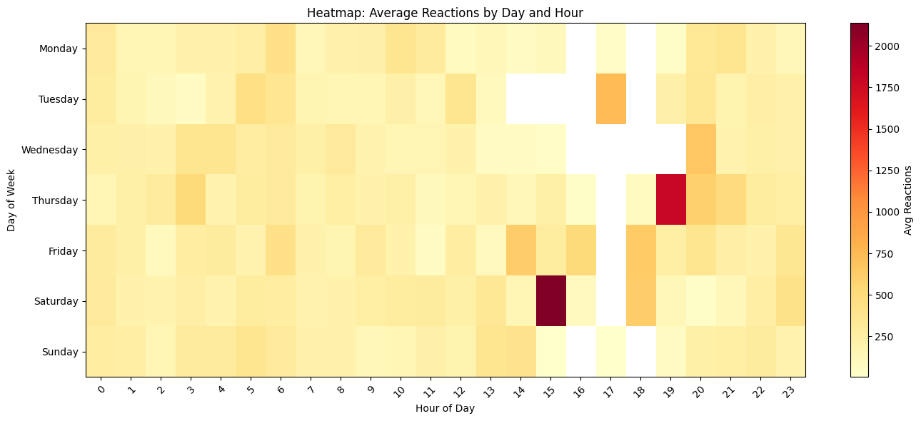
Average Reactions by Day and Hour
Heat Map
Analysis
Absolute Peak:
Saturday 3 PM: Highest engagement with 2000+ reactions.
High Engagement Slots:
Wednesday 7 PM: Strong engagement (1750+), ideal for content drops.
Thursday 6 PM: Deep red zone (~1500–1750), great for reach.
Tuesday 4 PM: Reliable slot with ~900–1000 reactions.
Day Patterns:
Wednesday: Evening peak at 7 PM – great for conversions.
Thursday: Consistent engagement from 3–7 PM.
Saturday: Strong mid-afternoon activity at 3 PM.
Tuesday: Sharp peak at 4 PM, otherwise low.
Monday, Friday, Sunday: Low and steady engagement, no clear peaks.

Slide 11
Time + Day = Viral Opportunity
Best time to post:
Saturday 15:00 (3 PM)
Wednesday 19:00 (7 PM)
Thursday 18:00 (6 PM)
Secondary windows:
Tuesday 16:00 (4 PM)
Thursday 17:00–19:00
Avoid posting during:
Early morning hours (especially 0:00–10:00)
Most hours on Monday and Sunday, which show very light engagement

Slide 12
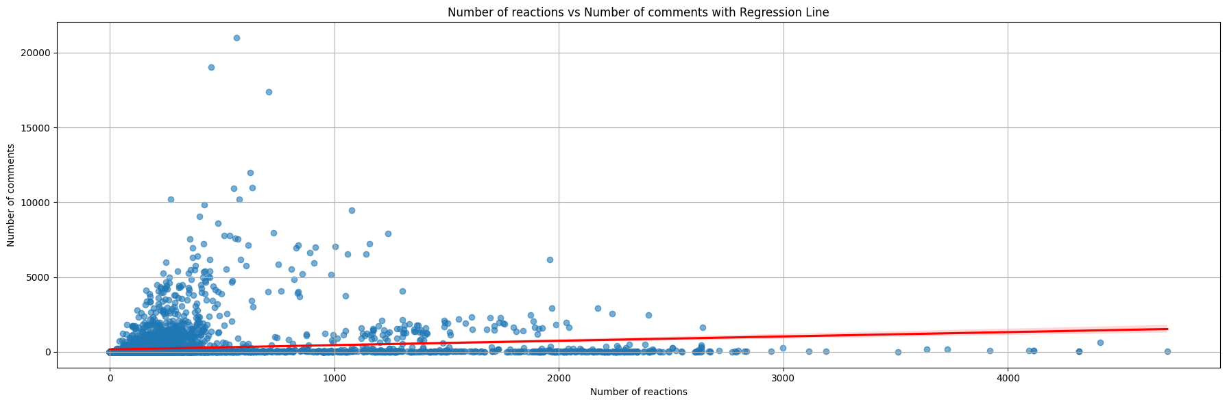
Correlation: No. of Reactions & No. of Comments
Scatter Plot with Regression Line
Identifying the Correlation
Type: Weak positive correlation between reactions and comments.
Pearson Coefficient: 0.15 → only 2.25% of comment variation is explained by reactions.
Insights:
Most posts have low reactions and comments.
A few outliers show high engagement.
The regression line confirms a slight upward trend.
High reactions don’t guarantee high comments and vice versa.

Slide 13
Engagement Isn’t Just Reactions — Drive Real Conversations
Key Insights:
Reactions ≠ Comments: They reflect different user behaviors.
Track Separately: Optimize reactions for reach, comments for deeper engagement.
Goal-Oriented Content: Tailor content based on whether you're targeting awareness or interaction.
Recommendations:
Avoid assuming high reactions will lead to comments.
Use strategies like questions/polls to drive comments.
Monitor both metrics independently for better insights.
Align content type with intended engagement (e.g., emotional posts for reactions, thought-provoking for comments).

Slide 14
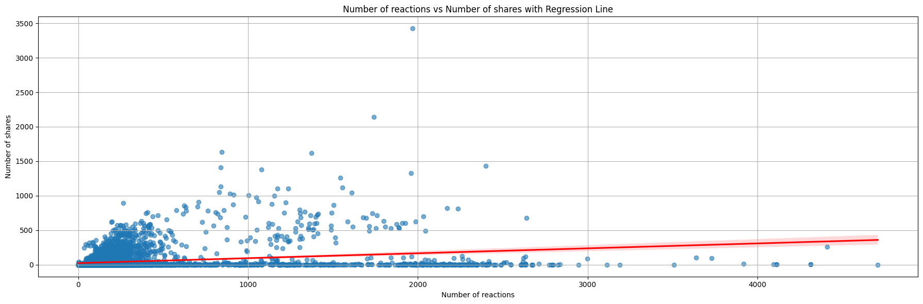
Correlation: No. of Reactions & No. of Shares
Scatter Plot with Regression Line
Identifying the Correlation
Type: Weak positive correlation
Pearson Coefficient: 0.25 → only 6.25% of share variation explained by reactions
Insights:
Slight upward trend; confirmed by regression line
Most posts have low reactions and shares
Some outliers have very high shares (up to 3,400+)
Stronger than reactions–comments (0.15), but still weak overall

Slide 15
Crack the Share Code: Going Beyond Likes
Recommendations:
Don’t rely on reactions alone — high reactions don’t guarantee high shares.
Track share patterns to identify what content drives sharing.
Study viral posts to uncover traits of highly shareable content.
Content Strategy:
Monitor share-to-reaction ratio to spot impactful content.
Prioritize content that encourages sharing — it offers greater reach and business value.

Slide 16
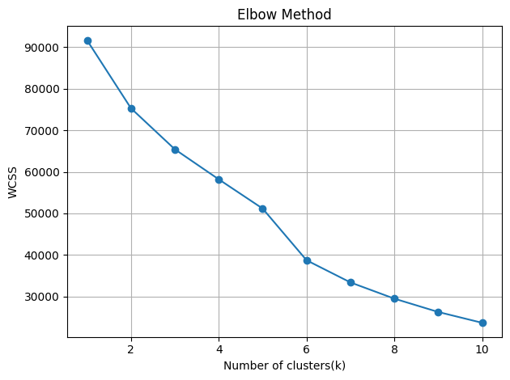
Elbow Method
Elbow Plot
Interpretation
Approach:
Applied KMeans clustering with k ranging from 1 to 10
Computed WCSS (Within-Cluster Sum of Squares) for each value of k
Key Finding: A clear elbow point observed at k = 6
Interpretation:6 clusters strike the optimal balance between:
Minimizing WCSS (tighter, more cohesive clusters)
Avoiding overfitting (excessively granular segmentation)
Conclusion: k = 6 is the most suitable choice for effective and interpretable clustering in this dataset.

Slide 17
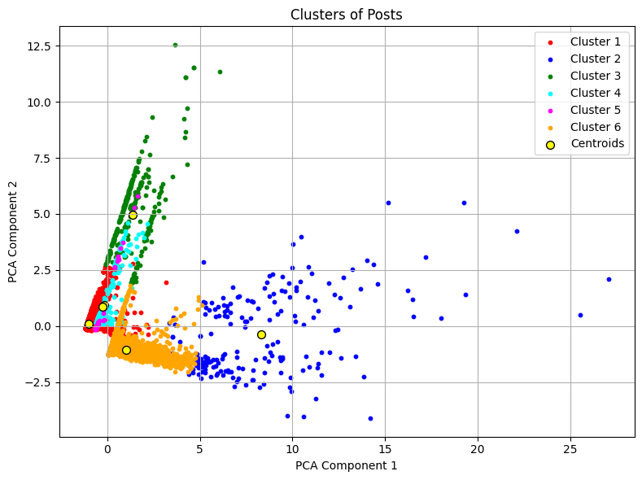
2D PCA Cluster
2D PCA Scatter Plot
Interpretation
What the Plot Shows:
Posts are grouped into 6 distinct clusters in a reduced 2D feature space
While some overlap exists, clusters are largely well-separated
Interpretation:
Clusters represent similar engagement patterns
Significance:
Enables identification of behavioral patterns in content engagement
Assists in tailoring targeted content strategies per cluster type

Slide 18
Cluster Analysis
Cluster 1 – Passive Photo Posts
Mostly photo posts with low reactions, comments, and shares — common but not impactful.
Cluster 2 – Viral Video Boosters
Highly engaging videos with massive comment and share counts — your go-to for virality.
Cluster 3 – Like-Magnet Content
Photo-heavy posts that attract tons of likes but little interaction beyond that.
Cluster 4 – Basic Status Updates
Pure status posts with moderate engagement — text-driven and straightforward.
Cluster 5 – Quiet Link Shares
Link posts with low interaction but modest shareability — great for subtle promotion.
Cluster 6 – Discussion Starter Videos
Video posts that spark conversation — moderate reactions but high comment activity.

Slide 19
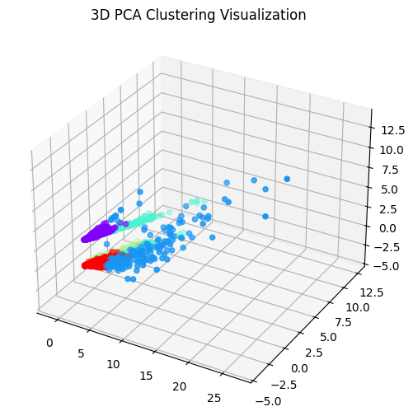
3D PCA Cluster
3D PCA Scatter Plot
Interpretation
Why 3D?
Captures more variance from the original dataset compared to 2D
Offers richer insights into post distribution and engagement patterns
What It Reveals:
Some clusters are tightly packed, indicating consistent engagement
Others are more dispersed, reflecting varied post behavior
Highlights subtle differences between post types that may be missed in 2D
Benefit:
Enhances understanding of high-dimensional relationships
Supports more granular segmentation of content based on engagement traits

Slide 20
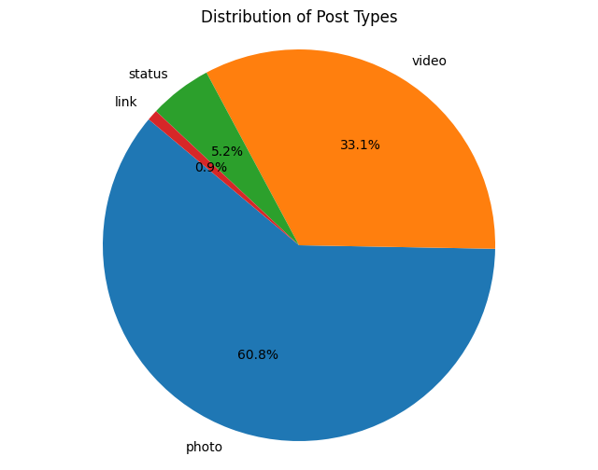
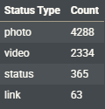
Post Type Distribution
Pie Chart
Figures
Interpretation
Photos make up over 60% of all posts, with videos as the next most common type.
Status and link posts are relatively rare.
Videos, though less common, often show higher engagement potential.
Key Takeaway: More posts ≠ better engagement — content quality matters more than quantity.

Slide 21
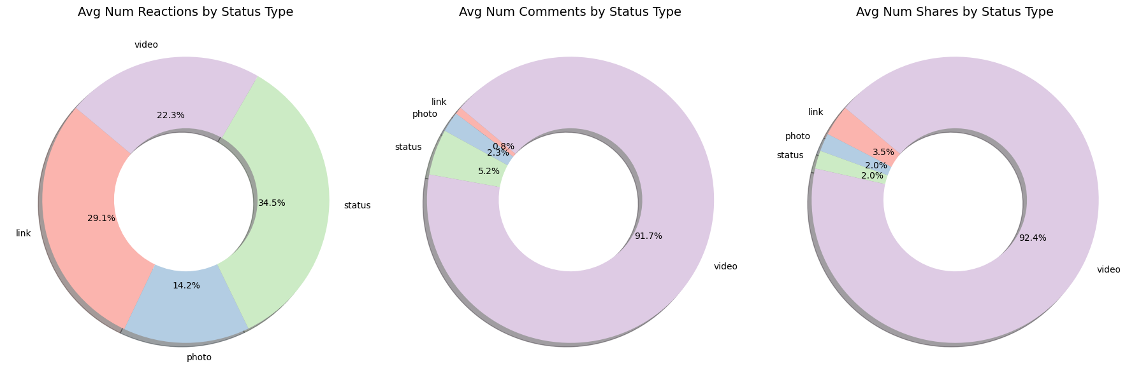
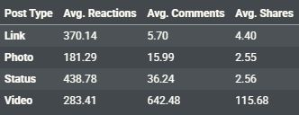
Engagement by Post Type
Pie Chart
Figures
Interpretation
What the Data Shows:
Videos drive the most comments and shares
Status posts get the most reactions
Photos are common but low in engagement
Link posts are rare but highly shareable
Takeaway: Choose post types based on your goal — reactions, shares, or comments — not just frequency.

Slide 22

Thank You.
"Marketing without data is like driving with your eyes closed." — Dan Zarrella
Presented by: Tanush Garg

